Slide 1
Academy for Business Careers, Data & Entrepreneurship (ABCDE) - Placement Analysis
- A Case Study by Anik Chakraborty

Slide 2
🎯 Objective
To develop an interactive Placement Analytics Dashboard to evaluate student placement performance and identify key salary drivers at Academy for Business Careers, Data & Entrepreneurship (ABCDE).
Project Purpose:
Analyze placement outcomes across gender, specialization, degree type, and work experience
Identify academic and demographic factors influencing placement success
Examine salary distribution and CGPA-to-salary trends
Provide actionable insights for institutional improvement
Key KPIs:
Total Students: 215
Placed Students: 148
Placement Rate: 68.84%
Average Salary: ₹198.70K
Maximum Salary: ₹940K
Placement Rate by Degree Type & Specialization
Deliverables:
Interactive Power BI Dashboard
Executive Presentation
Insights & KPI Summary Report

Slide 3
📘 Project Overview
Context Highlights:
Analyzed 215 student placement records (AY 2025–26)
Evaluated academic metrics – degree type, specialization, CGPA
Assessed demographics – gender, work experience
Examined placement status and salary outcomes
Demonstrates how data analytics empowers institutional decisions to optimize placement strategies and student performance evaluation.
Built an interactive Placement Analytics Dashboard using Power BI. Key insights derived on:
Overall placement rate and salary distribution
CGPA-to-salary correlation patterns
Gender and background-based placement trends
Specialization-wise salary contributions

Slide 4
🗂️ Data Overview & Schema
Data Source:
Source: Institutional placement dataset (simulated academic dataset)
Data Type: Structured student-level records
Time Period: Academic Year 2025–26
Data Structure & Metrics:
Key Index Type: Student-level unique ID
Total Rows: 215
Categories:
Demographics: Gender, Work Experience
Academics: Degree Type, Specialization, CGPA
Placement: Placement Status, Salary
Calculated Metrics:
placement_flag (1 = Placed, 0 = Not Placed)
Placement Rate %
Average Salary
Degree-wise Placement Distribution

Slide 5
💻 Tech Stack
Tools:
Excel
Data cleaning & preprocessing
Power Query
Data Transformation & Shaping
Column Standardization
Data Preparation for BI Integration
Power BI
Dashboard & Visualization
Data Modeling & Relationship Building
DAX (DAX – KPI Calculations Columns & Measures)
Slicers & Dynamic Filtering
PowerPoint
Presentation and final dashboard snapshots

Slide 6
📈 Methodology & Analysis
Preparation, Process & Analytical Approach:
Data Preparation & Cleaning:
Removed missing and inconsistent values
Standardized categorical fields
Validated salary and placement records
Data Modeling & Integration:
Built an optimized data model
Established relationships between academic and placement dimensions
Feature Engineering:
Created placement_flag metric
Derived Placement Rate %
Visualization Design:
Designed KPI Cards for summary metrics
Used Donut Chart for gender distribution
Applied Bar & Clustered Charts for specialization and salary insights
Implemented Interactive slicers for dynamic filtering
Validation & Formatting:
Verified KPI calculations against raw totals
Applied consistent dashboard theme and formatting
Optimized layout for executive readability

Slide 7
❓ Problem Statement
Institutions collect placement data but often lack a centralized analytical dashboard to evaluate performance drivers in a structured manner.
This results in limited visibility into:
Overall placement efficiency and conversion rates
Degree-wise placement contribution and disparities
Specialization-level performance differences
Gender-based salary variations
Academic background impact on salary outcomes
Key Questions :
What is the overall placement rate of the college?
How many students are placed vs unplaced?
Which specialization (Marketing & Finance vs Marketing & HR) delivers stronger placement and salary outcomes?
How does degree type (Commerce & Management, Science & Technology, Others) influence placement success?
Is there a gender-based salary gap?
What are the average and maximum salary levels across segments?
How does academic background drive salary performance?
Which student segments contribute most to overall placement outcomes?
How can these insights help improve training focus and placement strategy?

Slide 8
💡 Key Insights
Top Findings:
~69% placement rate (148 of 215 students)
Marketing & Finance specialization shows stronger placement and salary performance
Science & Technology students achieve highest average salary (~₹0.22M)
Commerce & Management has highest student participation (145 students)
Male students show higher average salary compared to female students
Clear positive relationship between academic background and salary
Supporting Metrics:
Total Students: 215
Placed Students: 148
Unplaced Students: 67
Placement Rate: 68.84%
Average Salary: ₹198.70K
Maximum Salary: ₹940K
Commerce & Management: 145 students
Science & Technology: 59 students
Others: 11 students

Slide 9
📍 Conclusion
Summary:
The placement analysis of Academy for Business Careers, Data & Entrepreneurship (ABCDE) reveals clear and measurable trends in student performance and employment outcomes.
Science & Technology students achieve the strongest salary outcomes, while Commerce & Management has the highest student participation. A clear performance gap is visible across degree types.
Specialization and gender influence placement and salary outcomes, with Marketing & Finance demonstrating stronger placement efficiency and higher salary performance compared to other specializations.
The interactive dashboard provides a comprehensive, data-driven view of placement performance, enabling administrators to refine training strategies, align curriculum with industry demands, and identify improvement areas across student segments.
Overall, this project demonstrates how structured analytics and visualization can strengthen institutional decision-making, improve placement strategies, and enhance student career outcomes.

Slide 10
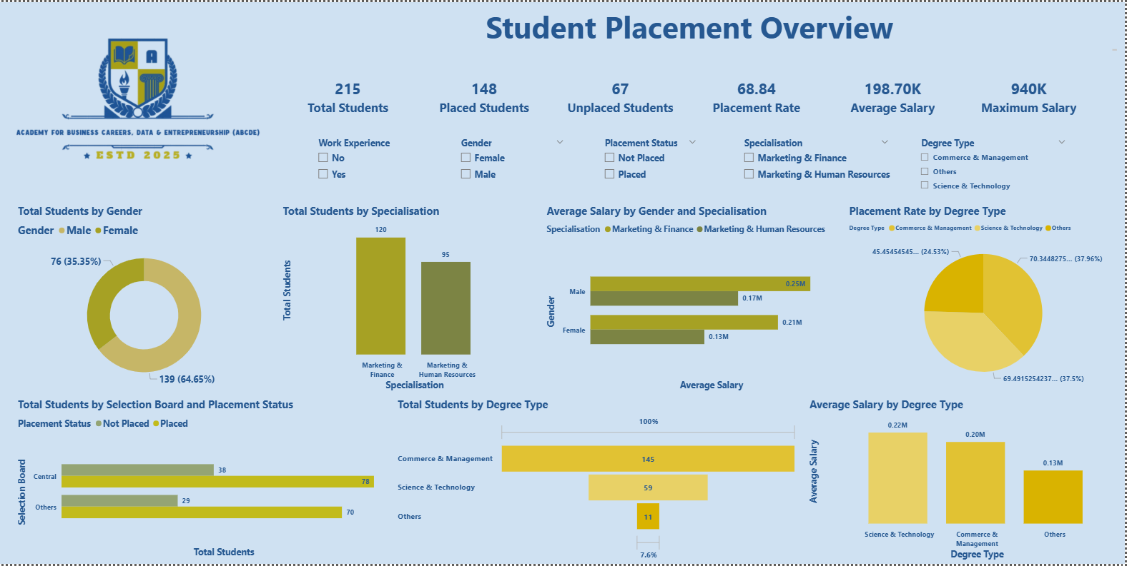
🖥️Dashboard Overview – Placement Overview

Slide 11
✅ Business Impact & Use Cases
College Administration & Management
Leverage placement analytics to evaluate program-level performance
Identify academic strengths and gap areas
Plan strategic improvements in curriculum and training initiatives
Training & Placement Cell
Monitor placement trends and conversion rates
Target underperforming student segments and specializations
Strengthen industry partnerships through data-backed reporting
Faculty & Academic Departments
Understand how degree type and specialization influence placement outcomes
Align curriculum with high-performing academic domains
Guide mentorship using performance-based insights
Students & Career Advisors
Understand how specialization, and academic background impact salary outcomes
Make informed decisions about career focus and skill development
Set realistic expectations regarding placement and compensation trends
Recruiters & Industry Partners
Identify high-performing academic segments
Access data-backed insights on student quality and specialization strengths
Optimize recruitment strategy and hiring pipelines

Slide 12
🙏 Acknowledgement & Contact
Project Analyst: Anik Chakraborty 📧 Email: anikc1710@gmail.com
Special Thanks To:
Coding Ninjas – for project framework and guidance
Connect: 🔗 GitHub | 🔗 LinkedIn

Slide 13
Thank You!

